Slide 1


Self-check 2
Unit check 2
UNIT 2

Slide 2
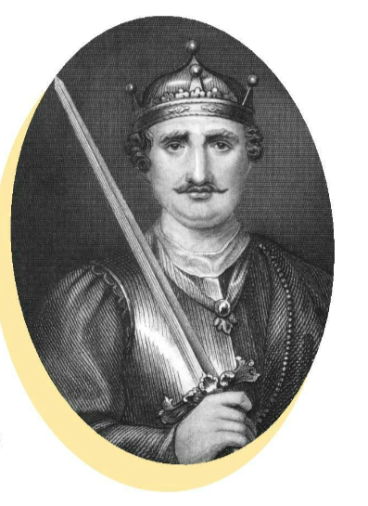
How much do you know about William the Conqueror? Play this quiz and find out.
https://wordwall.net/play/846/574/545

Slide 3
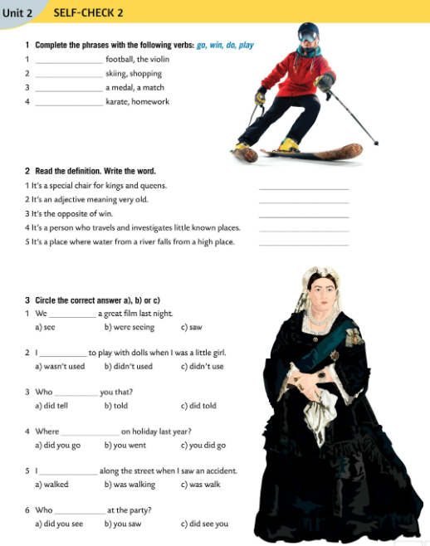
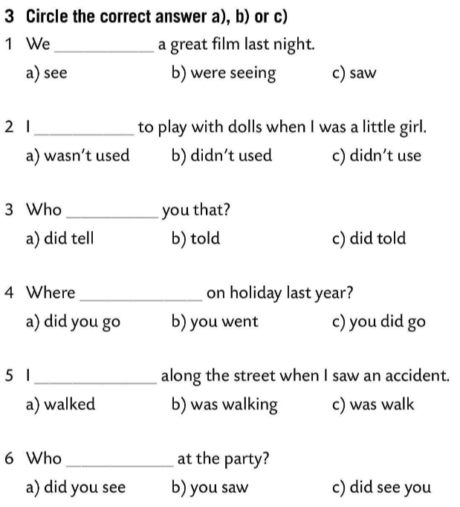
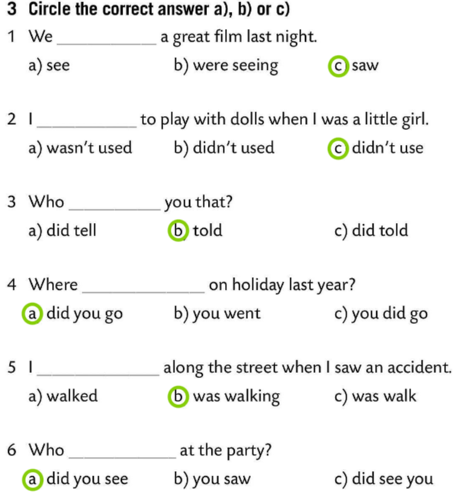
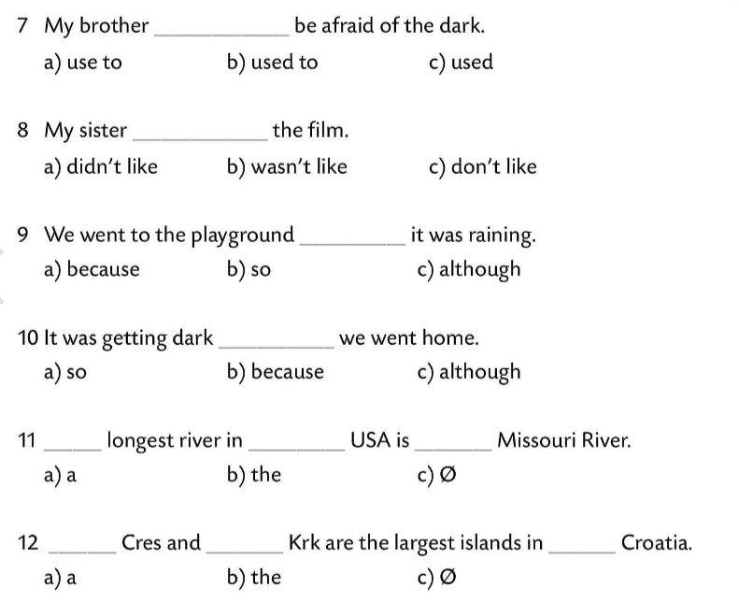
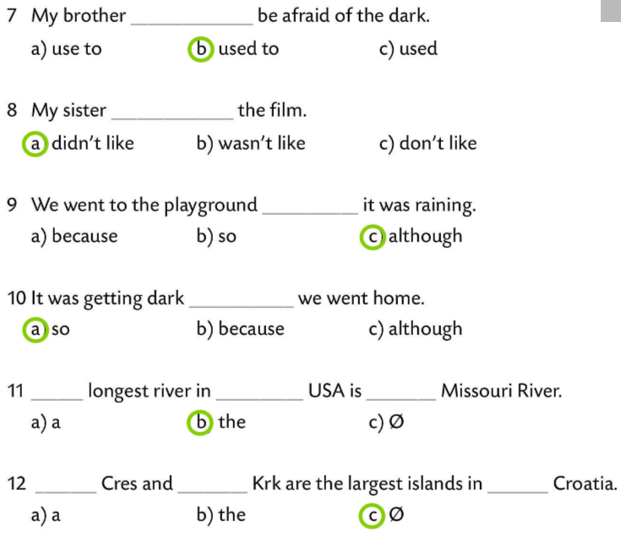
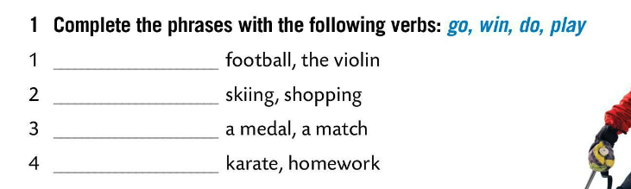
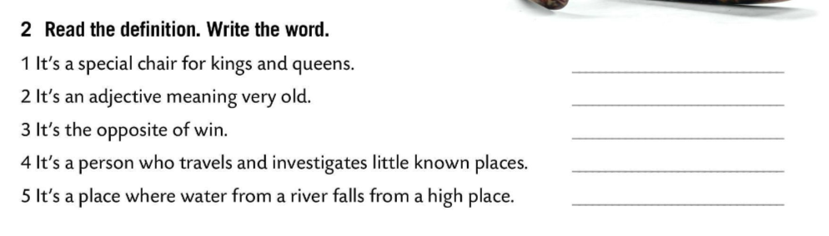
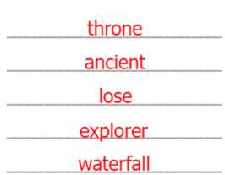
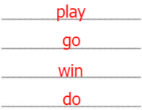
Complete the phrases with the following verbs: go, win, do, play.
Check.
Read the definiton. Write the word.
Check.
Circle the correct answer.
Check.

Slide 4
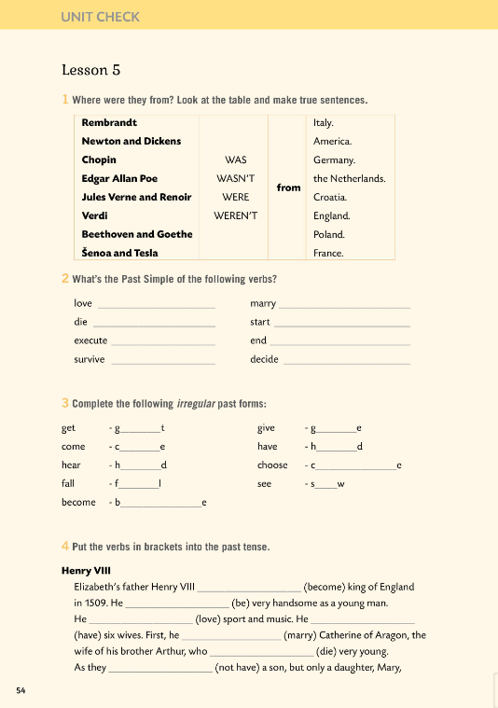
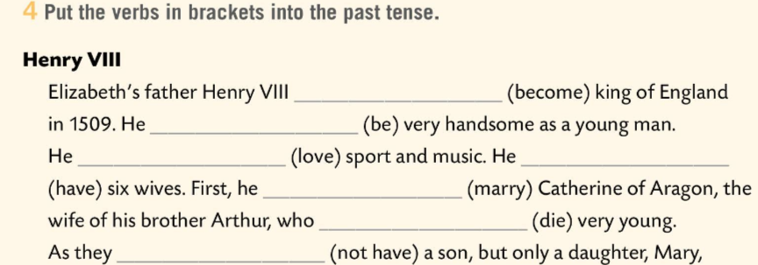
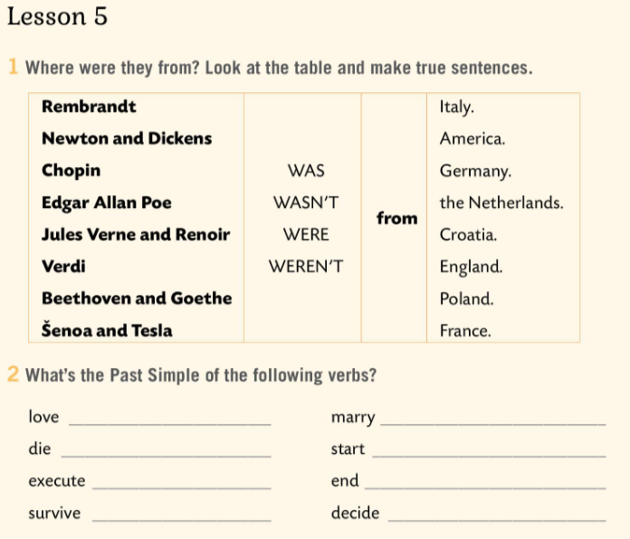

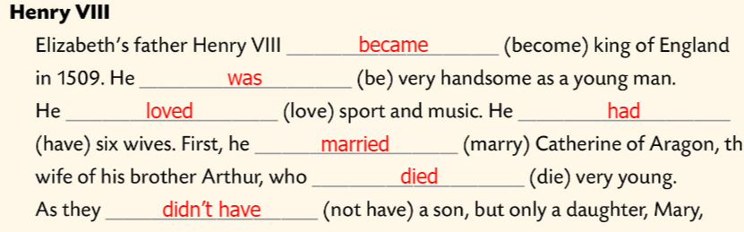
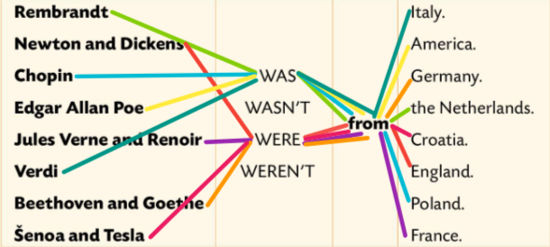
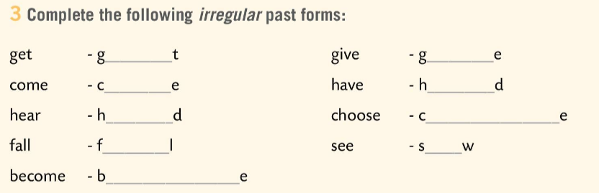
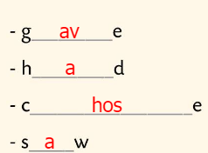
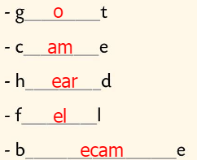
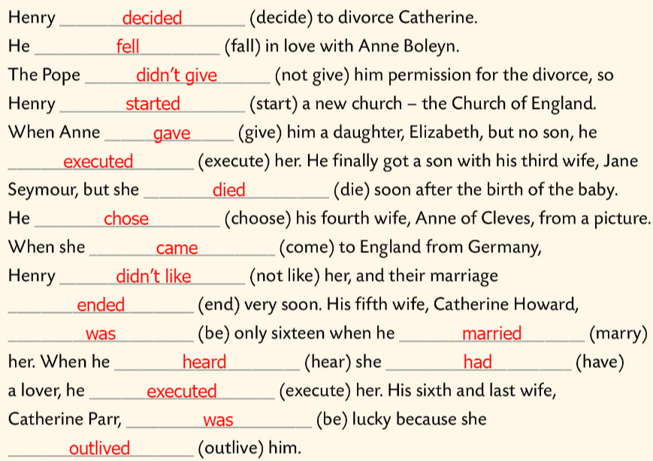
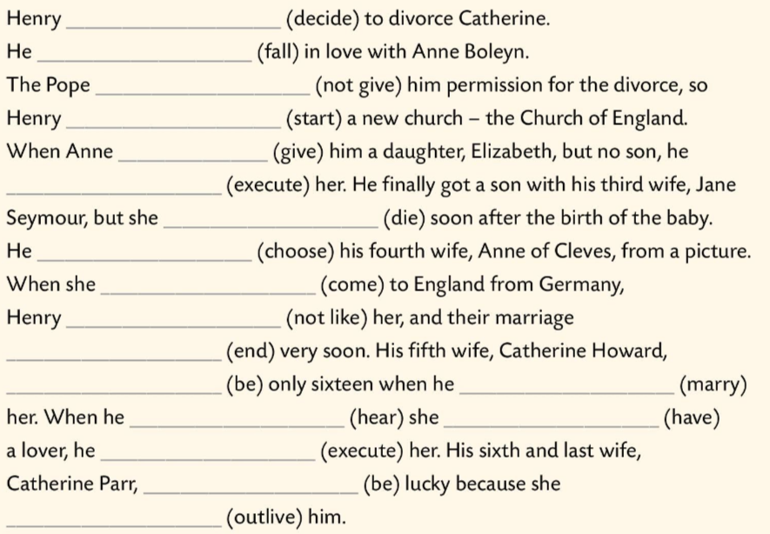
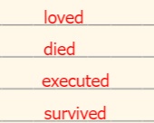
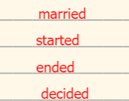
Workbook, p. 54 UNIT CHECK
Where were they from? Look at the table and make true sentences.
Check.
What’s the Past Simple of the following verbs?
Check.
Complete the irregular past forms.
Check.
Put the verbs in brackets into the past tense and check.

Slide 5
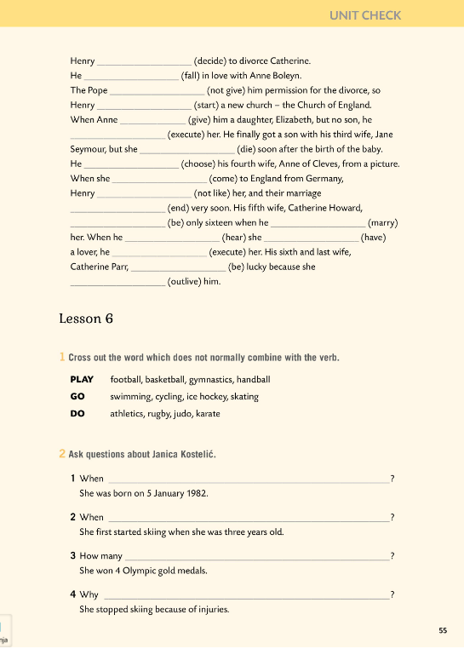
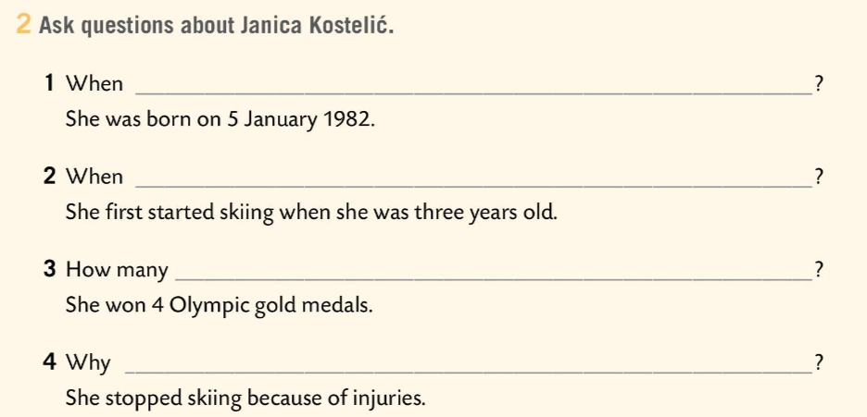
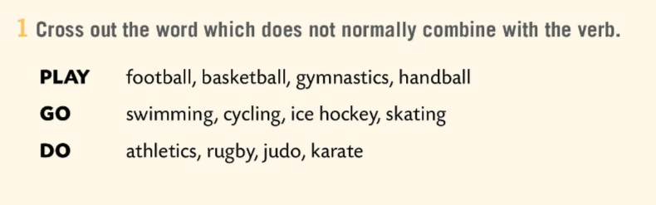
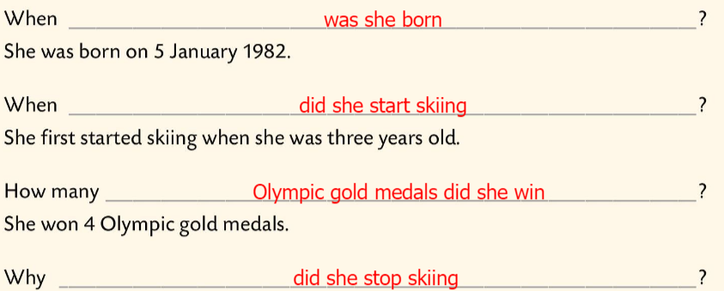
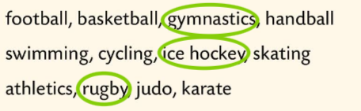
Workbook, p. 55 UNIT CHECK
Cross out the word which does not normally combine with the verb.
Check.
Ask questions about Janica Kostelić.
Check.

Slide 6
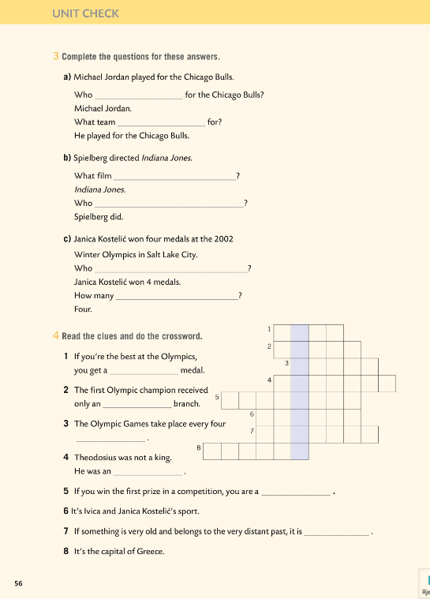
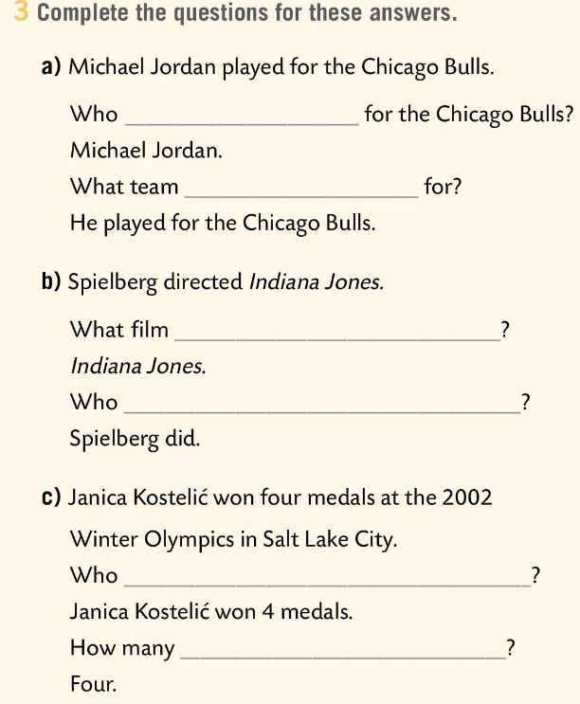
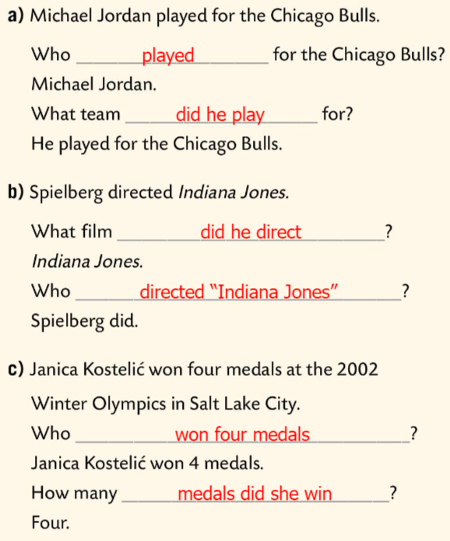
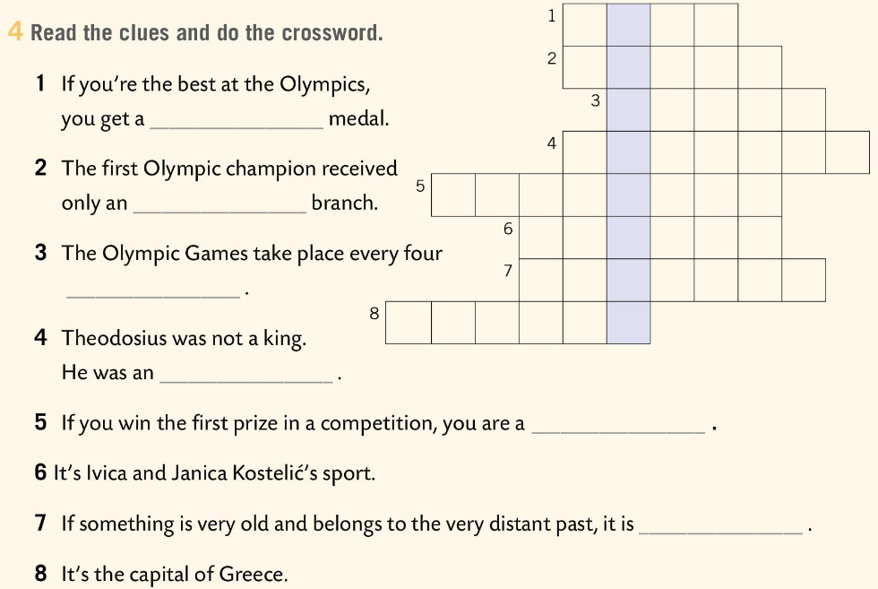
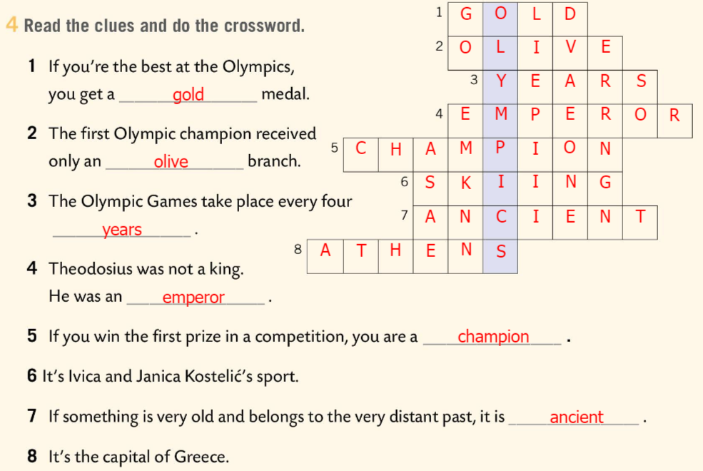
Workbook, p. 56 UNIT CHECK
Complete the questions for these answers.
Check.
Read the clues and do the crossword.
Check.

Slide 7
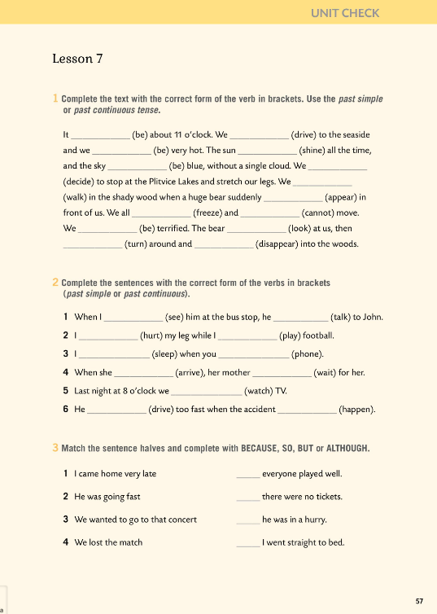
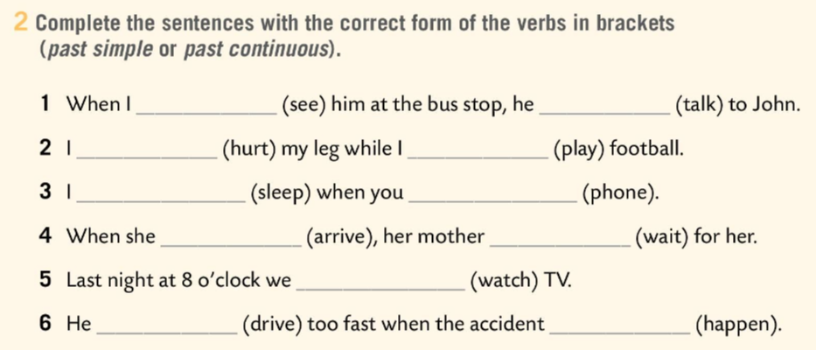
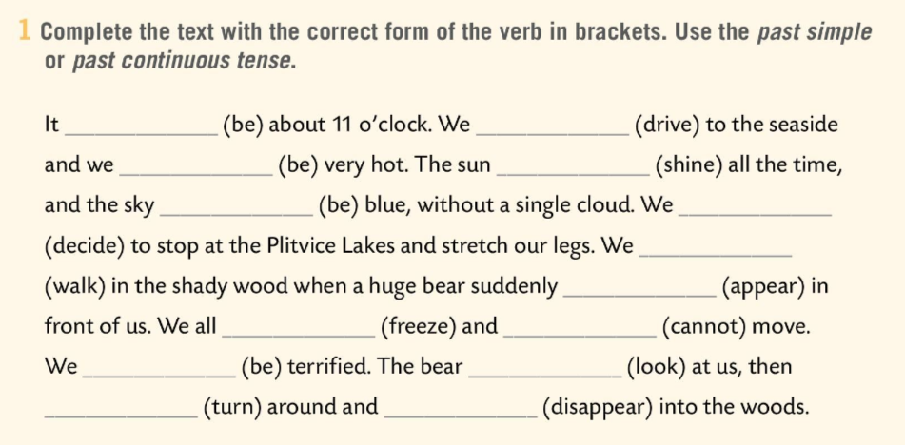
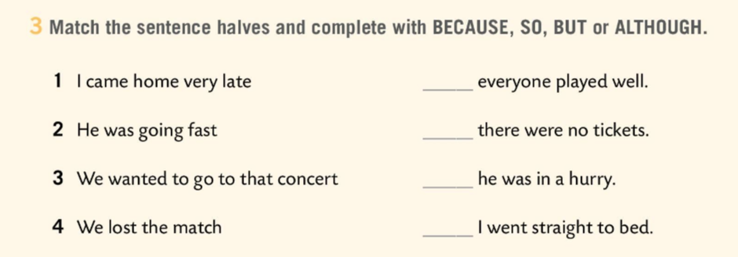
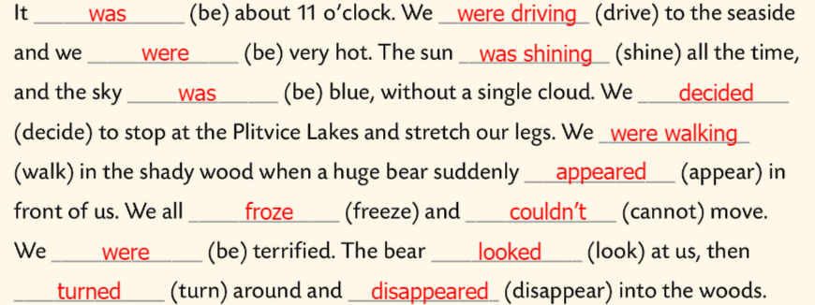
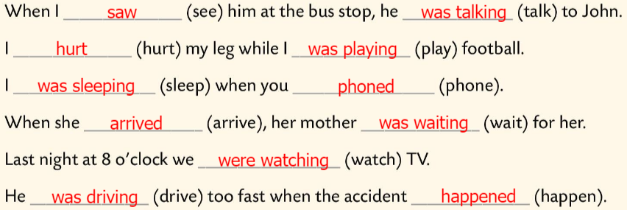
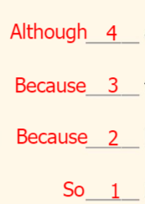
Workbook, page 57 UNIT CHECK
Complete the text with the correct form of the verb in brackets. Use the past simple or past continuous tense.
Check.
Complete the sentences with the correct form of the verbs in brackets (past simple or past continuous tense).
Check.
Match the sentence halves and complete with BECAUSE, SO, BUT or ALTHOUGH.
Check.

Slide 8
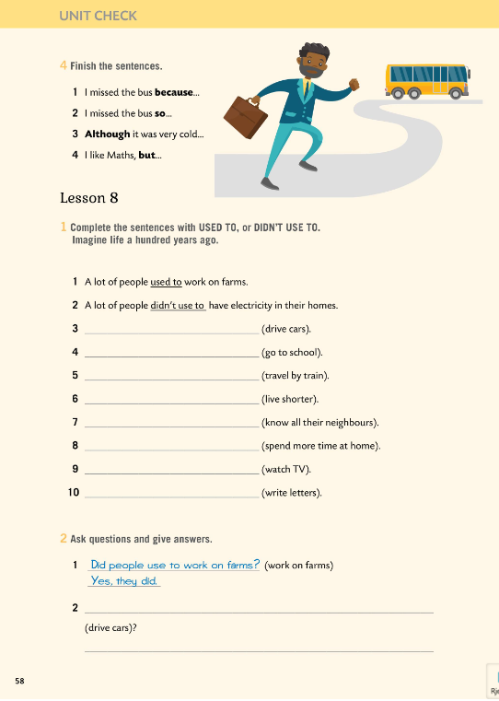
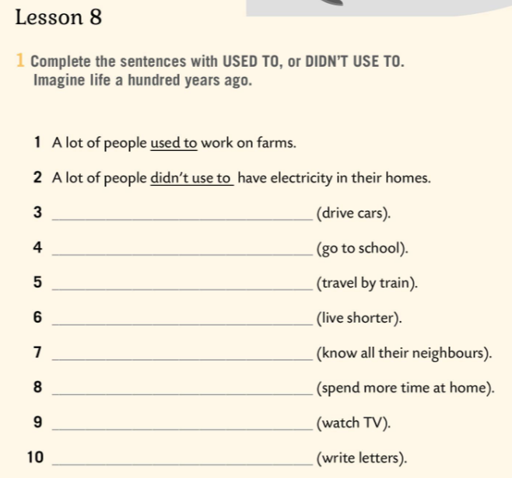
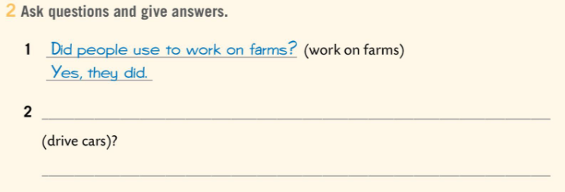
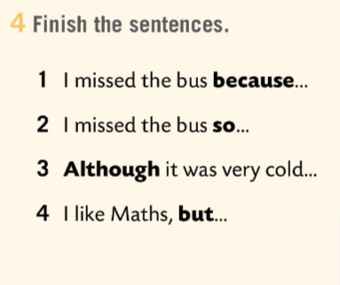
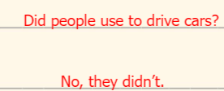
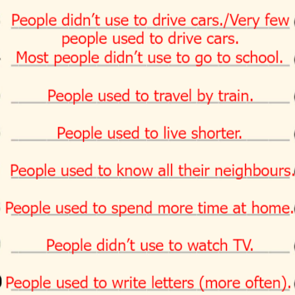
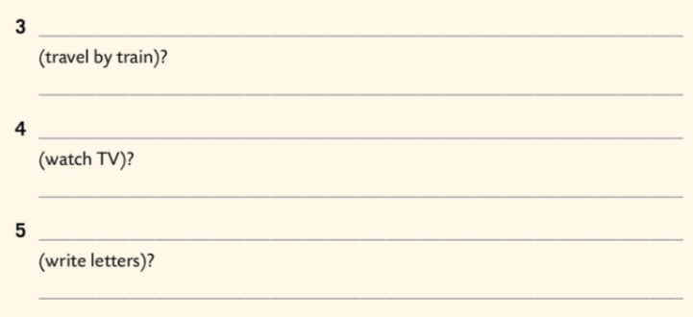
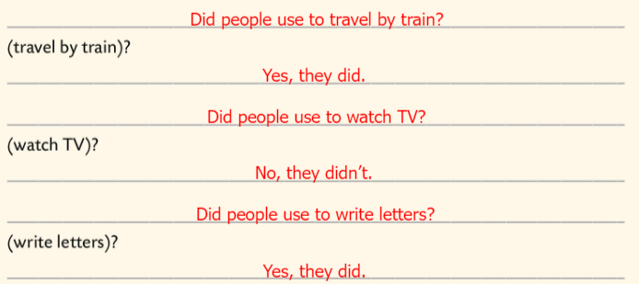
Workbook, p. 58 UNIT CHECK
Finish the sentences.
Complete the sentences with USED TO, or DIDN’T USE TO.
Imagine your life hunderd years ago.
Check.
Ask questions and give answers.
Check.

Slide 9
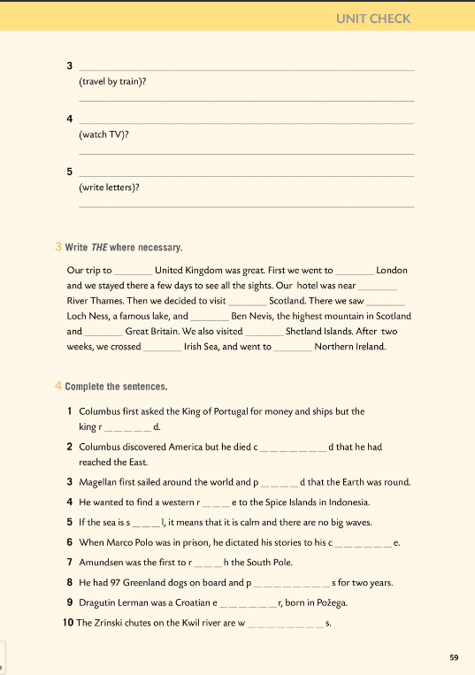
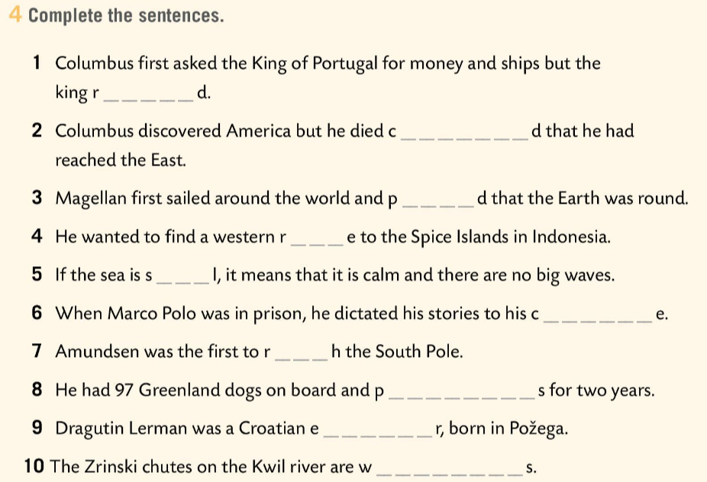
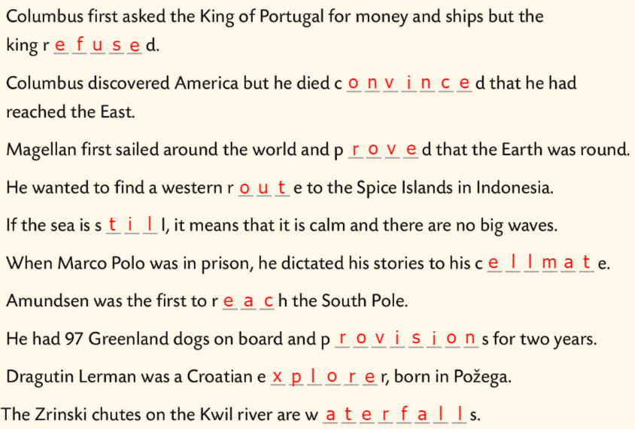


Workbook, p. 59 UNIT CHECK
Write THE where necessary.
Check.
Complete the sentences.
Check.

Slide 10


Workbook, p. 60 UNIT CHECK
Tick all the words/expressions you can translate. Look up the others in the word list.
Mark all the adjectives with a little star * and underline all the verbs.
Find words that can be used to describe someone’s character and choose three that are positive and three that are negative, in your opinion.
Write down the words/expressions you’d like to remember.

Slide 11



Workbook, p. 61 UNIT CHECK
Tick the statements that are true for you.

Slide 12


Which outcomes did you master very well?
Which ones need more improvement and which need more time and practice?

